Slide 1
Throwing exceptions

Slide 2
Outline
In this lesson, we will:
See that we can throw objects
Know that there are classes defined in the standard template library
These classes allow more information to be passed back
That inform can be retrieved
Revisit the function std::stoi
Learn that exceptions that cannot be dealt with can be re-thrown

Slide 3
Exceptions
We have discussed throwing and catching exceptions:
#include <iostream>
int f( int n );
int main();
int f( int n ) {
if ( n == 0 ) {
throw 0;
}
return 1000000/n;
}
int main() {
int value;
try {
std::cout << "Enter an integer: ";
std::cin >> value;
std::cout << "1/n = " << f( value ) << "*1e-6" << std::endl;
} catch ( int err ) {
std::cout << "division-by-zero error" << std::endl;
}
return 0;
}
Output:
Enter an integer: 0
division-by-zero error

Slide 4
Throwing objects
Problem: Primitive types cannot convey a lot of information
Solution: Instances of classes can be thrown, and caught, too
Specifically, C++ has a number of classes devoted to conveying information about exceptions:
In the exception header file, the class std::exception is defined
This class is virtual—it is not possible to create an instance of it
However, it forms the base class for a number of exceptions

Slide 5
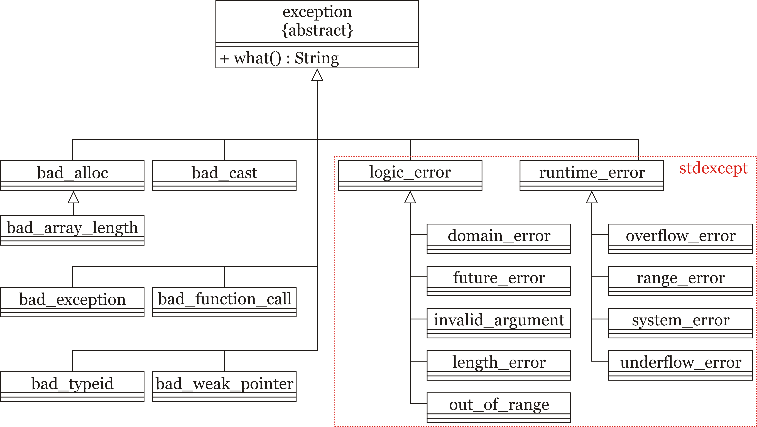
Throwing objects
All exception classes are derived from the exception class
Many common exceptions are in the stdexcept library

Slide 6
Throwing objects
If we had the following cascading catch series:
try {
// Try some code...
} catch ( std::logic_error &e ) {
std::cout << e.what() << std::endl;
// do something for logic errors in programming...
} catch ( std::runtime_error &e ) {
std::cout << e.what() << std::endl;
// do something for run-time errors...
} catch ( std::exception e ) {
std::cout << e.what() << std::endl;
// do something for *all* other exceptions
}

Slide 7
Throwing objects
If we had the following cascading catch series:
try {
// Try some code...
} catch ( std::logic_error &e ) {
std::cout << e.what() << std::endl;
// do something for logic errors in programming...
} catch ( std::runtime_error &e ) {
std::cout << e.what() << std::endl;
// do something for run-time errors...
} catch ( std::exception &e ) {
std::cout << e.what() << std::endl;
// do something for *all* other exceptions
}
This will catch:
logic_error
domain_error
future_error
length_error
invalid_argument
out_of_range

Slide 8
Throwing objects
If we had the following cascading catch series:
try {
// Try some code...
} catch ( std::logic_error &e ) {
std::cout << e.what() << std::endl;
// do something for logic errors in programming...
} catch ( std::runtime_error &e ) {
std::cout << e.what() << std::endl;
// do something for run-time errors...
} catch ( std::exception &e ) {
std::cout << e.what() << std::endl;
// do something for *all* other exceptions
}
This will catch:
runtime_error
overflow_error
range_error
system_argument
underflow_error

Slide 9
Throwing objects
If we had the following cascading catch series:
try {
// Try some code...
} catch ( std::logic_error &e ) {
std::cout << e.what() << std::endl;
// do something for logic errors in programming...
} catch ( std::runtime_error &e ) {
std::cout << e.what() << std::endl;
// do something for run-time errors...
} catch ( std::exception &e ) {
std::cout << e.what() << std::endl;
// do something for *all* other exceptions
}
This will catch any other exception that is derived from the exception class either directly or indirectly

Slide 10
Exceptions
We can use this exception:
#include <iostream>
#include <stdexcept>
int f( int n );
int main();
int f( int n ) {
if ( n == 0 ) {
throw std::domain_error( "division-by-zero error" );
}
return 1000000/n;
}
int main() {
int value;
try {
std::cout << "Enter an integer: ";
std::cin >> value;
std::cout << "1/n = " << f( value ) << "*1e-6" << std::endl;
} catch ( std::logic_error &e ) {
std::cout << e.what() << std::endl;
}
return 0;
}
Output:
Enter an integer: 0
division-by-zero error

Slide 11
Exceptions
The standard template library stdexcept defines ten derived classes:
logic_error Logic error exception (class)
domain_error Domain error exception (class)
future_error Future error exception (class)
length_error Length error exception (class)
out_of_range Out-of-range error exception (class)
invalid_argument Invalid argument exception (class)
runtime_error Run-time error exception (class)
range_error Range error exception (class)
system_error System error exception (class)
overflow_error Overflow error exception (class)
underflow_error Underflow error exception (class)

Slide 12
Exceptions
Each class is to be used in sometimes subtly different circumstances
Logic errors
domain_error | When the argument does not satisfy a domain (e.g., x ≥ 0)
future_error | When something has occurred that will adversely affect a future state
length_error | When an array or string is the incorrect capacity (length)
out_of_range | When an index is beyond the range of an array
invalid_argument | Any other issue with invalid or inconsistent arguments
logic_error | Any other general issues with invalid or inconsistent states
Run-time errors
range_error | When a calculation produces a value outside a specific range
overflow_error | When a calculation produces an arithmetic overflow
system_error | When an issue arises from the operating system
underflow_error | When a calculation produces an arithmetic underflow
runtime_error | Any other issue that can only ever be detected while executing

Slide 13
Exceptions
You can declare your own derived classes:
#include <string>
#include <stdexcept>
class Coded_exception : public std::logic_error {
public:
Coded_exception( string const what_arg, int code );
int code() const; // Return an error code
private:
int error_code;
};
Coded_exception::Coded_exception( string const what_arg, int code ):
std::logic_error( what_arg ),
error_code( code ) {
// Do something...
}
int Coded_exception::code() const {
return error_code;
}

Slide 14
Exceptions
You are now able to throw your coded exception whenever necessary:
void communication_initialization( /* args */ ) {
// Do something
for ( ... ) {
// ...
if ( ... ) {
throw Coded_exception( "Invalid communications port", 35 );
}
while ( ... ) {
// ...
if ( ... ) {
throw Coded_exception( "Unknown source", 15 );
}
}
}
}

Slide 15
Exceptions
You can now catch this exception:
int main() {
// Perform some set up
try {
communication_initialization( /* args */ );
} catch ( Coded_exception &e ) {
std::cout << "Error message: \"" << e.what() << "\"" << std::endl;
std::cout << "Error code: " << e.code() << std::endl;
}
// Continue processing...
return 0;
}

Slide 16
Exceptions
Your new exception will still be caught as a logic error:
int main() {
// Perform some set up
try {
communication_initialization( /* args */ );
} catch ( std::logic_error &e ) {
std::cout << "Error message: \"" << e.what() << "\"" << std::endl;
// std::cout << "Error code: " << e.code() << std::endl;
}
// Continue processing...
return 0;
}
You cannot call e.code() because all
the compiler knows is that this is an
instance of a logic error, and it has no
way of ensuring that it is a coded exception.
example.cpp: In function 'int main()':
example.cpp:29:24: error: 'class std::logic_error' has no member named 'code'
std::cout << e.code() << std::endl;
^

Slide 17
The function std::stoi
You can now better understand the description of the string-to-integer function
We simply said it throws an exception if something goes wrong
We can now understand these exceptions better:
If no conversion could be performed, an invalid_argument exception is thrown.
If the value read is out of the range of representable values by an int, an out_of_range exception is thrown.

Slide 18
The function std::stoi
We can now attempt to parse a string more intelligently, dealing with possible issues:
int count{}; // uninitalized
try {
count = std::stoi( argv[1] ); // Convert the string to an integer
} catch ( std::invalid_argument &e ) {
std::cout << e.what() << std::endl;
std::cout << "Expecting the first argument to be an integer, "
"but got \"" << argv[1] << "\"" << std::endl;
return EXIT_FAILURE;
} catch ( std::out_of_range &e ) {
std::cout << e.what() << std::endl;
std::cout << "The first argument, \"" << argv[1]
<< "\", is too large to be stored as an 'int'"
<< std::endl;
return EXIT_FAILURE;
}

Slide 19
Summary
Following this lesson, you now
Understand you can throw instances of classes
Know that all standard exceptions are derived from the std::exception class
Understand that catching an exception will also catch any derived exception that is thrown
Know how to author your own derived exception classes

Slide 20
References
[1] No references?

Slide 21



Colophon
These slides were prepared using the Georgia typeface. Mathematical equations use Times New Roman, and source code is presented using Consolas.
The photographs of lilacs in bloom appearing on the title slide and accenting the top of each other slide were taken at the Royal Botanical Gardens on May 27, 2018 by Douglas Wilhelm Harder. Please see
https://www.rbg.ca/
for more information.

Slide 22
Disclaimer
These slides are provided for the ece 150 Fundamentals of Programming course taught at the University of Waterloo. The material in it reflects the authors’ best judgment in light of the information available to them at the time of preparation. Any reliance on these course slides by any party for any other purpose are the responsibility of such parties. The authors accept no responsibility for damages, if any, suffered by any party as a result of decisions made or actions based on these course slides for any other purpose than that for which it was intended.

